Slide 1
Project Development
(For Term-1 & Term-2)
Presented By:
Ms Suman, PGT CS
KV Dinjan

Slide 2
General Instructions
Term – 1 : Synopsis of the project is to be submitted by the students (documentation only, may not submit the code during Term - 1)
Term – 2 : Final coding + Viva voce (Student will be allowed to modify their Term 1 document and submit the final executable code.)

Slide 3
General Instructions
Project is to be created using
i) Python file handling/Python-SQL connectivity for CS students
ii) Pandas and CSV or database file for IP students.
Groups of two to three students.
Relate to the real world problem.
Project should be started atleast 6 months before the submission deadline.

Slide 4
General Instructions
Students can use a wide variety of Python libraries to create user friendly applications such as games, software for their school, software for their disabled fellow students, and mobile applications etc.
Students should be sensitized to avoid plagiarism and violations of copyright issues while working on projects.

Slide 5
Distribution of Marks for the Project
Sr No | Class | Subject | Marks |  | Total Marks
 |  |  | Term-1 (Project Synopsis) | Term-2 (Final Project Submission)
1. | XII | IP | 2 | 3 | 5
2. | XII | CS | 3 | 5 | 8

Slide 6
Synopsis
Draft

Slide 7

The first page should contain
Project Name
Name of the Candidate(s),
Teacher’s Name,
School Name
Year of AISSCE

Slide 8
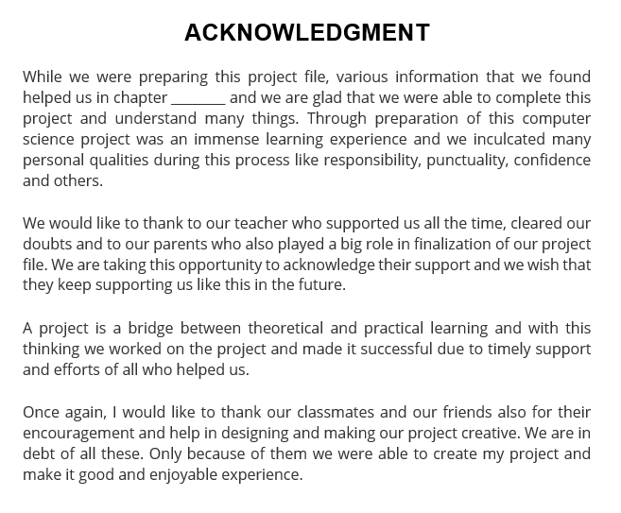
Acknowledgement

Slide 9
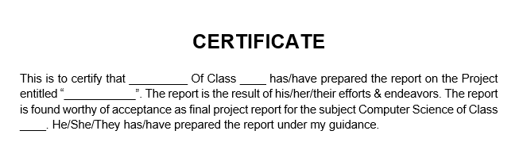
Certificate

Slide 10
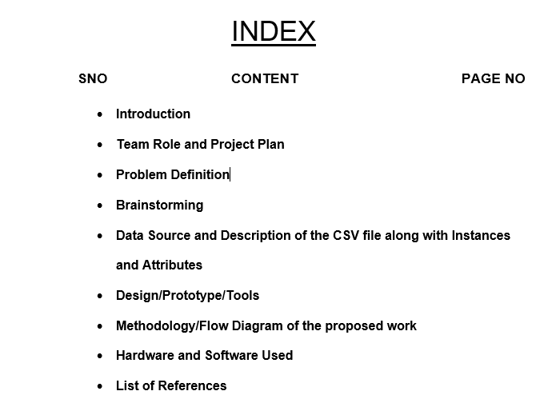
Index

Slide 11
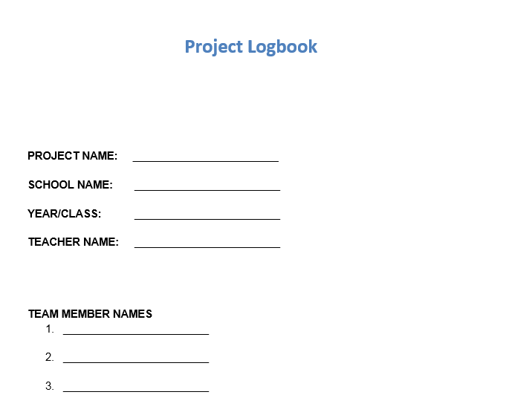
Project Logbook

Slide 12
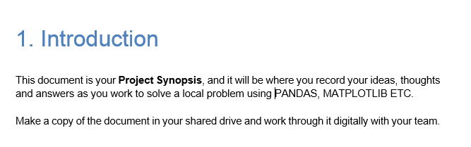
Introduction About the Program

Slide 13
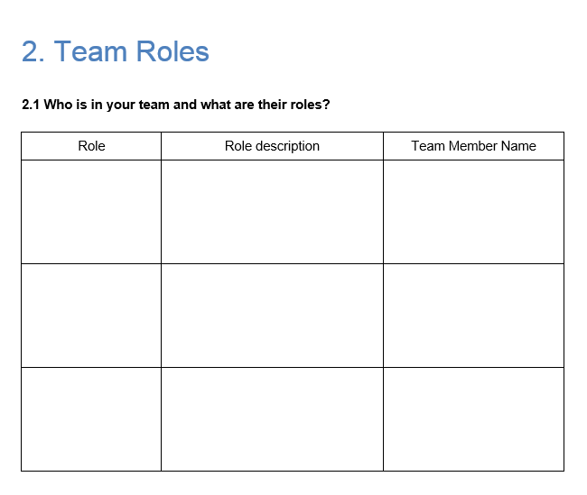
Team Roles
Team Roles should include details such as:
Who is in your team and what are their roles?

Slide 14
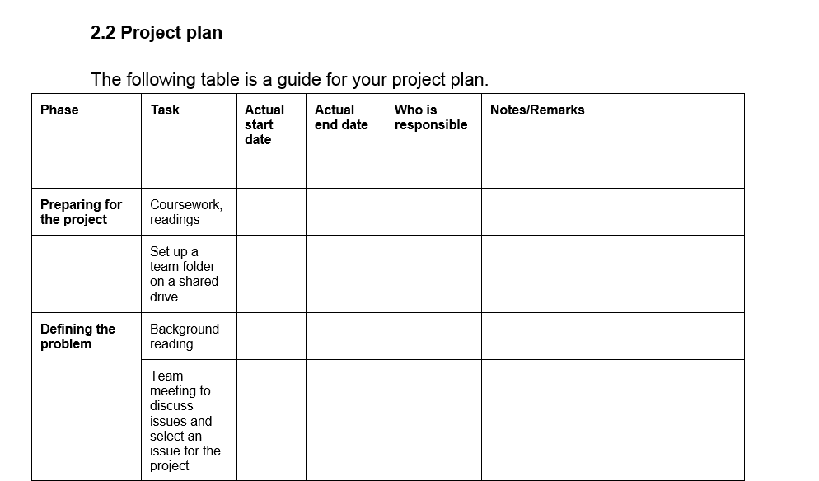
Project Plan

Slide 15
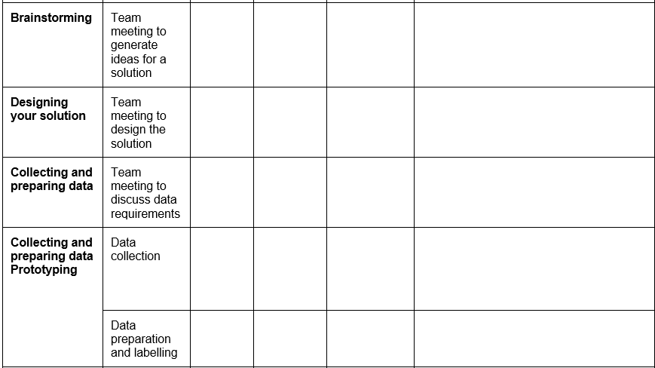
Project Plan

Slide 16
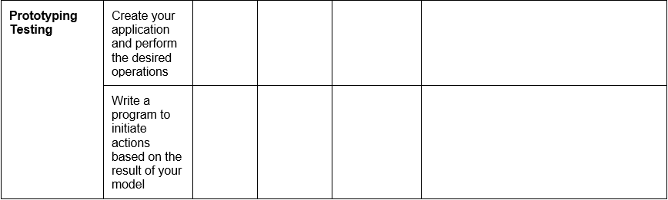
Project Plan

Slide 17
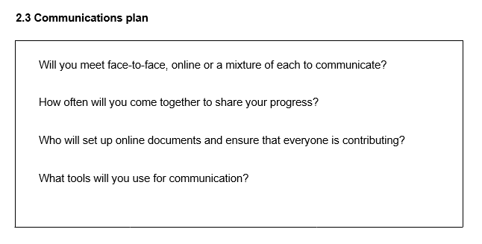
Communication Plan
How often are you planning to meet to discuss your project?
How are you planning to communicate?
What tools are being used?

Slide 18
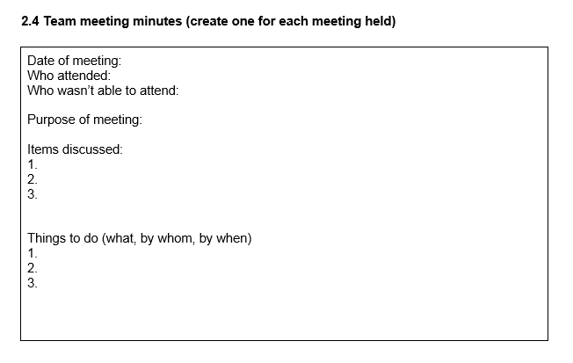
Details About the Meeting
Date of the meeting held.
Who attended.
Who couldn’t attend.
Purpose of meeting.
Items discussed.
Things to do in making of the project

Slide 19
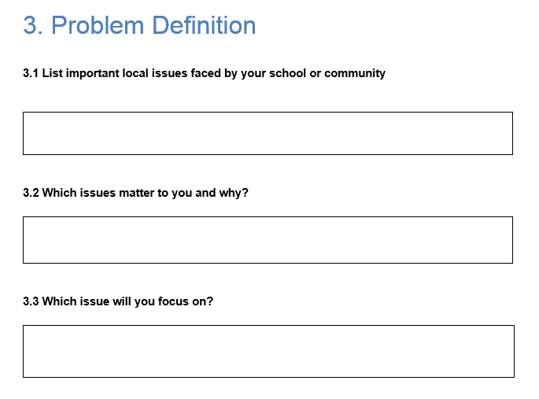
Problem Definition
Problem Definition should include details such as:
List important local issues faced by your school or community
Which issues matter to you and why?
Which issue will you focus on?

Slide 20
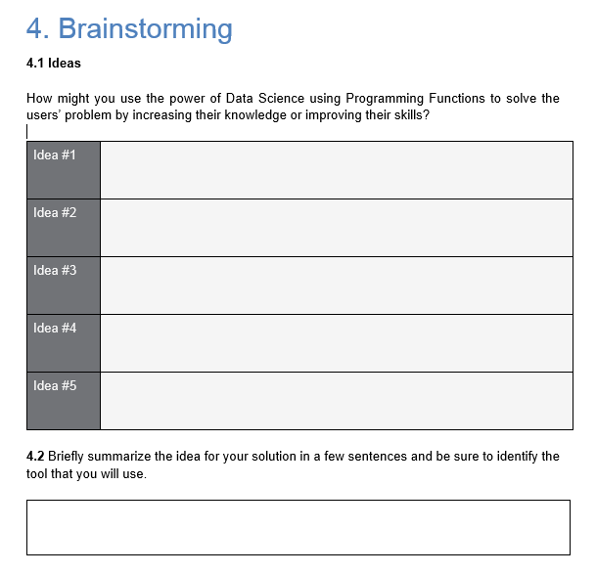
Brainstorming
“Brainstorming” should include details such as:
Ideas regarding the usage of project.
Brief summary of the idea of the solution mentioning the tools used in it.

Slide 21
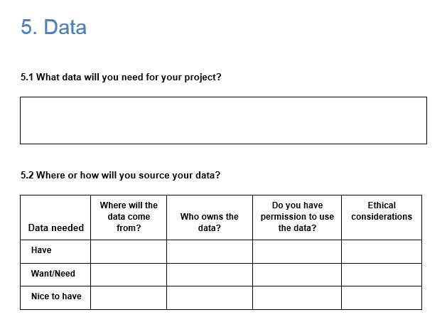
Data
“Data” should include details about:
The data you will need to complete the project.
How will you source your data?

Slide 22
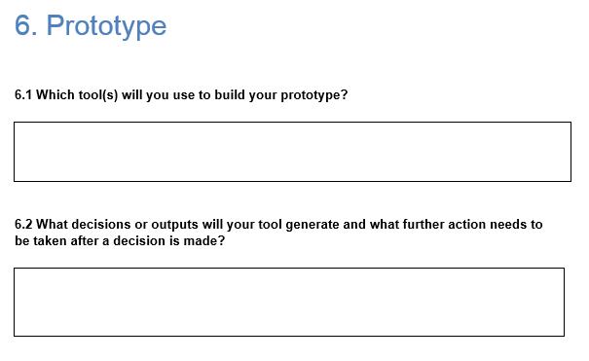
Prototype
“Prototype” should include details about:
The tool(s) required to build the prototype.
Output and decision making process.

Slide 23
Project Synopsis (contd..)
Methodology/Flow Diagram of the proposed work
Hardware and Software Used
List of References

Slide 24
THANK YOU

